Slide 1

PROJECT – 1
HEALTH STATUS AND AIR QUALITY ANALYSIS FOR THE YEAR 2017

Slide 2
List topic/introduction
Sources ; the API and Csv
We chose 2017 for more recent data from both sources to analyze
Nitrogen Dioxide and Ozone are two air pollutants recognized as harmful to humans by the EPA and both are regulated in the United States. They are released in the air most often due to burning of fossil fuels.
Hypothesis: If the air quality is low, there will be higher levels of obesity. If there are air pollutants, the overall health of a state will be lowered. In the presence of pollutants Nitrogen Dioxide (NO₂) and Ozone, there will be higher instances of obesity or lower health standards as measured by states.
Sample size - csv file - 63,000 data points. API – data measurements from collection sites across 47 states.

Slide 3
Why we chose NO₂ and ozone
The EPA has identified six pollutants as “criteria” air pollutants because it regulates them by developing human health-based and/or environmentally-based criteria (science-based guidelines) for setting permissible levels. These six pollutants are carbon monoxide, lead, nitrogen oxides, ground-level ozone, particle pollution (often referred to as particulate matter), and sulfur oxides.
Source: https://www.cdc.gov/air/pollutants.htm
On our API, we had all parameters available for No2 and ozone among the 6 pollutants. We also tested
Effects of No2:
Breathing air with a high concentration of NO₂ can irritate airways in the human respiratory system. Such exposures over short periods can aggravate respiratory diseases, particularly asthma, leading to respiratory symptoms (such as coughing, wheezing or difficulty breathing), hospital admissions and visits to emergency rooms. Longer exposures to elevated concentrations of NO₂ may contribute to the development of asthma and potentially increase susceptibility to respiratory infections.

Slide 4
List the 9 questions
Percent of adults aged 18 years and older who have an overweight classification
Percent of adults aged 18 years and older who have obesity
Percent of adults who achieve at least 150 minutes a week of moderate-intensity aerobic physical activity or 75 minutes a week of vigorous-intensity aerobic activity (or an equivalent combination)
Percent of adults who achieve at least 150 minutes a week of moderate-intensity aerobic physical activity or 75 minutes a week of vigorous-intensity aerobic physical activity and engage in muscle-strengthening activities on 2 or more days a week
Percent of adults who achieve at least 300 minutes a week of moderate-intensity aerobic physical activity or 150 minutes a week of vigorous-intensity aerobic activity (or an equivalent combination)
Percent of adults who engage in muscle-strengthening activities on 2 or more days a week
Percent of adults who engage in no leisure-time physical activity
Percent of adults who report consuming fruit less than one time daily
Percent of adults who report consuming vegetables less than one time daily

Slide 5
We can talk about how we spilt the 3 Q’s and what analysis each of us performed with the 3 questions

Slide 6
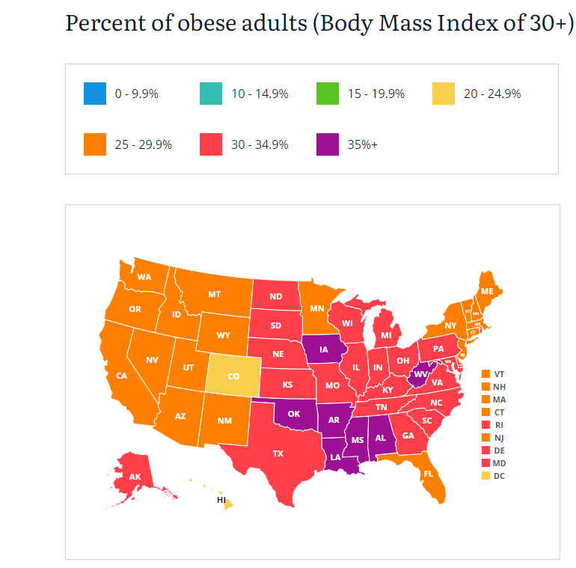
Source:https://stateofchildhoodobesity.org/adult-obesity/ This data is for 2017

Slide 7
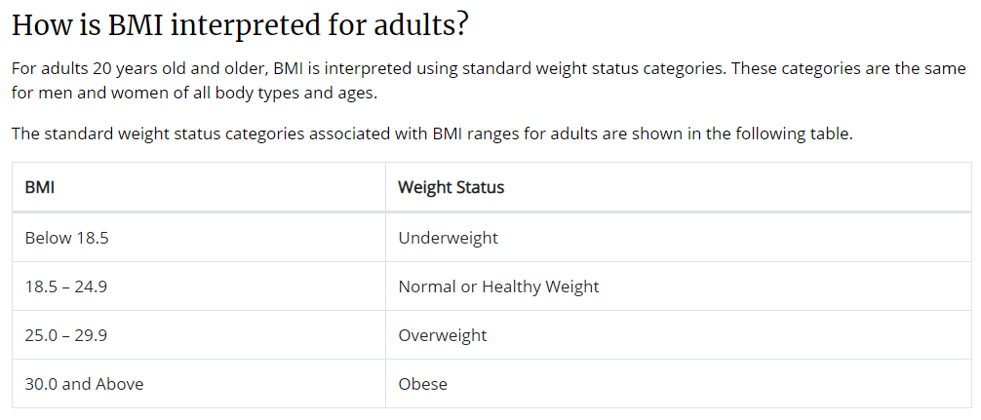
BMI CHART
https://www.cdc.gov/healthyweight/assessing/bmi/adult_bmi/index.html#InterpretedAdults
https://stateofchildhoodobesity.org/methodology/

Slide 8
FINDINGS:

Slide 9
LIMITATIONS:

Slide 10
Conclusion

Slide 11
REFERENCES
API’s used:
https://dev.socrata.com/foundry/chronicdata.cdc.gov/hn4x-zwk7
https://aqs.epa.gov/data/api/annualData/byState?
https://aqs.epa.gov/aqsweb/airdata/FileFormats.html
CSV File:
Behavioral Risk Factor Surveillance System
https://dev.socrata.com/foundry/chronicdata.cdc.gov/8mrp-rmkw
https://chronicdata.cdc.gov/Nutrition-Physical-Activity-and-Obesity/Nutrition-Physical-Activity-and-Obesity-Behavioral/hn4x-zwk7

